Slide 1
PROJECT TITLE Disease prediction using Machine Learning and Big Data
Team Details
Rathlavath Rajesh(20EG105401)
Gajjela Stevenson(20EG105412)
Neelagiri Chandradeep(20EG105429)
Project Supervisor
Ms. G. Sreeja

Slide 2
Introduction
The "Disease Prediction Using Machine Learning and Big Data" project is a cutting-edge initiative aimed at harnessing the power of advanced technology to enhance disease prediction, ultimately leading to more effective healthcare management. This project combines the expertise of data scientists, healthcare professionals, and technology specialists to create a comprehensive system for disease prediction and prevention.
We will need comprehensive healthcare data sources like electronic health records and genomic data. Additionally, we'll require a robust big data infrastructure and access to cloud computing resources for efficient data processing and scalability. Collaboration with healthcare experts and adherence to data security and privacy standards are crucial.
The application of disease prediction using machine learning and big data is transformative across healthcare. It empowers early disease detection, personalized healthcare, and efficient resource allocation. Healthcare professionals use it for decision support, while public health benefits from outbreak prediction and management.

Slide 3
Problem Statement
Problem Statement:-
To improve the accuracy of disease diagnosis by using machine learning algorithms to predict diseases based on the symptoms given.
Illustrate the problem:-
With the increasing number of deaths due to diseases, it has become mandatory to develop a system to predict effectively and accurately. The objective of our project is to develop a robust and accurate disease prediction system by using machine learning and Big Data analytics. Using large amounts of medical data, including patient records, genetic information, and environmental factors, we aim to create predictive models that can identify potential disease risks and outcomes. Our goal is to enhance early diagnosis, improve treatment planning, and ultimately contribute to better healthcare outcomes by providing clinicians and individuals with valuable insights into disease prevention and management.

Slide 4
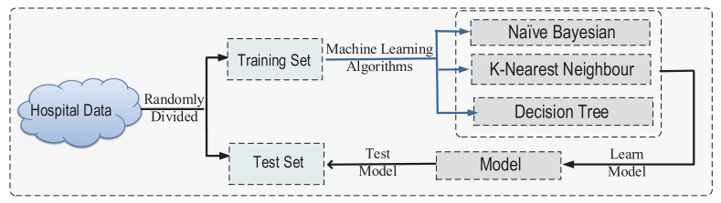
Proposed Method
The hospital data is randomly divided into training and testing sets of data. The machine learning algorithms such as Naïve Bayes, K-Nearest Neighbors, and Decision Tree and their models are built based on this data. These models are then trained extensively using the allocated training set of data. These trained models are then used to handle the test set of data and make accurate predictions about the diseases based on the data given. Finally, these predictions are displayed to the user.

Slide 5
Proposed Method
Illustration :
This prediction is basically done with the help of four different algorithms which are Decision Tree, Random Forest, KNN and Naïve Bayes. After user enters all the symptoms then he/she needs to press the buttons of respective algorithm, for example there are 4 buttons for 4 algorithms, if user enters all symptoms and presses only Random forest’s button then the result will be provided by calculating using only that algorithm.
KNN relies on similarities between patients, Decision Trees create interpretable decision rules, Naïve Bayes handles probabilistic relationships, and Random Forests enhance prediction accuracy through ensemble learning. This comprehensive method holds great promise in revolutionizing healthcare by enabling early and precise disease diagnosis and treatment planning.

Slide 6
Experiment Environment
Programming language used: Python since it is suitable for machine learning purposes
Code editor used: Visual Studio Code (Microsoft) as it is a light-weight code editor
Libraries used: NumPy for numeric operations, Pandas for preprocessing datasets, Sklearn to use the machine learning algorithms (Decision Trees, Random Forest, KNN, and Naive Bayes).

Slide 7
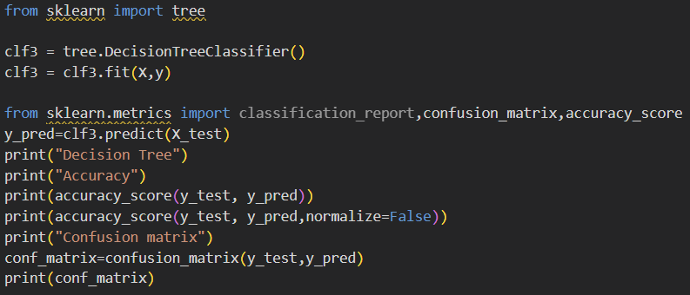
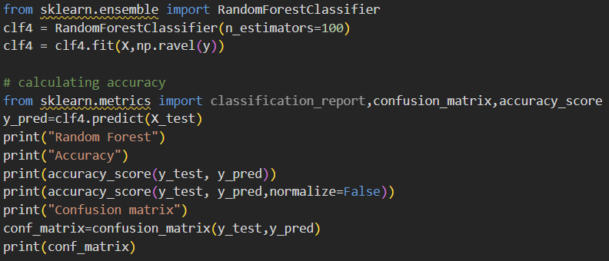
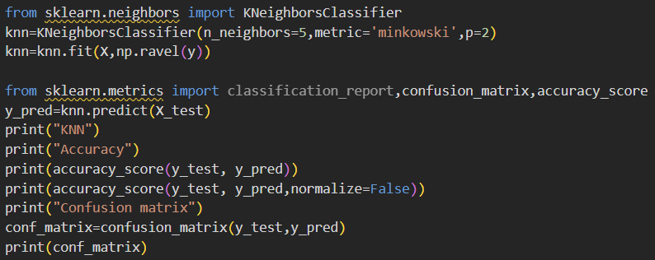
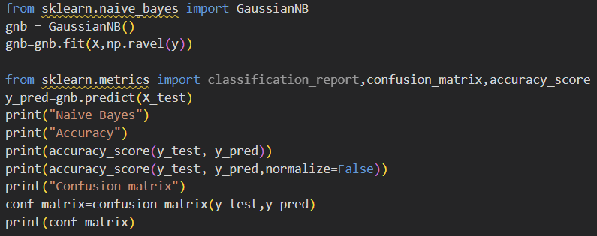
Experiment Screenshots

Slide 8
Experiment Results
During our project, we tested four different machine learning algorithms to see which one is the best at predicting diseases with the symptoms given as input.
We preprocessed the health data for this and trained and tested the machine learning model.
We found out that the Random Forest Algorithm had the best performance by getting an accuracy score of 95%.
The other algorithms, Decision Tree, KNN, and Naive Bayes, were also accurate with accuracy scores ranging from 86% to 93%.

Slide 9
Finding
We discovered that machine learning algorithms significantly enhance the accuracy and efficiency of disease prediction based on symptoms. The Random Forest algorithm is the most effective, achieving an accuracy of 95%, highlighting its ability to analyze symptom data and accurately predict diseases. The Decision Tree and KNN algorithms also had good performance with accuracies of 93% and 89% respectively, whereas the Naive Bayes algorithm attained an 86% accuracy. These findings highlight the potential to use advanced machine learning algorithms for disease prediction, offering a fast and precise diagnosis process compared to traditional methods. Also these speeds and accuracy can only improve with the increasing amount of data, hence it is very viable to use machine learning algorithms in disease prediction.

Slide 10
Justification
Parameters improved are:-
Accuracy: The overall correctness of the model in predicting diseases.
Accuracy = Number of correct predictions/Total number of predictions
Precision: The proportion of true positive predictions among all positive predictions made by the model.
Precision = True Positives/(True Positives + False Positives)
Recall (Sensitivity): The proportion of true positive predictions among all actual positives.
Recall = True Positives/(True Positives + False Negatives)
F1-Score: The harmonic mean of precision and recall, providing a balance between the two metrics.
F1-Score = 2*(Precision*Recall/(Precision + Recall))
The parameters improved because of Efficient Data Preprocessing, Algorithm Tuning, Feature Selection, and Cross-Validation.

Slide 11
Thank you

